Slide 1

CSE 464: Software Quality Assurance and Testing
Design Considerations of Object Oriented Applications for better Quality
Janaka Balasooriya

Slide 2
Design Considerations for OO applications
So far, we talked about removing bad coding by refactoring. In this lecture, we focus on improving the quality of the design. In particular, we will discuss
  Proper abstraction and encapsulation
  Inheritance and Polymorphism
  Quality matrices for OO design
You can use these guidelines in designing, evaluating, and refactoring the design

Slide 3
Fundamental Concepts
1. abstraction—data, interface, control
  Information hiding—controlled interfaces
  Inheritance and polymorphism
2. modularity—compartmentalization of data and function
  Functional independence—single-minded function and low coupling
3. architecture—the overall structure of the software
  patterns—”conveys the essence” of a proven design solution

Slide 4
Data Abstraction
door
manufacturer
model number
type
swing direction
inserts
lights
type
number
weight
opening mechanism
implemented as a data structure

Slide 5
Procedural Abstraction
open
details of enter
algorithm
implemented with a "knowledge" of the
object that is associated with enter

Slide 6
Information Hiding
module
• algorithm
controlled
interface
• data structure
• details of external interface
• resource allocation policy
clients
"secret"
a specific design decision

Slide 7
Why Information Hiding?
reduces the likelihood of “side effects”
limits the global impact of local design decisions
emphasizes communication through controlled interfaces
discourages the use of global data
leads to encapsulation—an attribute of high quality design
results in higher quality software

Slide 8
OO Application Example : Inheritance and Polymorphism

Slide 9
OO Application Example : Inheritance and Polymorphism
The term polymorphism literally means "having many forms"
A polymorphic reference is a variable that can refer to different types of objects at different points in time
The method called through a polymorphic reference can change from one invocation to the next
All object references in Java are potentially polymorphic

Slide 10
Polymorphism
Suppose we create the following reference variable:
Vehicle car;
This reference can point to a Vehicle object, or to any object of any compatible type such as Car
This compatibility can be established using inheritance or using interfaces
Careful use of polymorphic references can lead to elegant, robust software designs

Slide 11
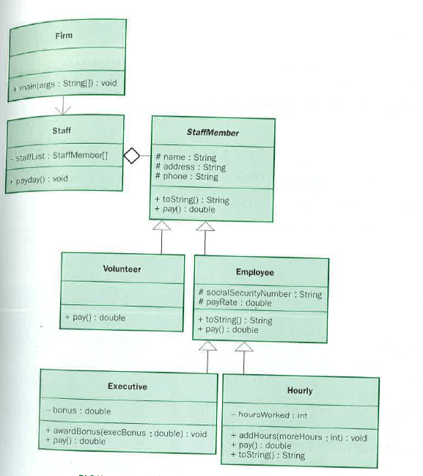
Polymorphism via Inheritance

Slide 12
//********************************************************************
// Firm.java Author: Lewis/Loftus
//
// Demonstrates polymorphism via inheritance.
//********************************************************************
public class Firm
{
//-----------------------------------------------------------------
// Creates a staff of employees for a firm and pays them.
//-----------------------------------------------------------------
public static void main (String[] args)
{
Staff personnel = new Staff();
personnel.payday(); }
}
payday() method calls the pay() method of all the staff members stored in the StaffMembes array of the Staff object instance personnel.
pay() method to call is determined at runtime based on the object instance reference

Slide 13
Output from Firm Program
Output
Name: Sam
Address: 123 Main Line
Phone: 555-0469
Social Security Number: 123-45-6789
Paid: 2923.07
-----------------------------------
Name: Carla
Address: 456 Off Line
Phone: 555-0101
Social Security Number: 987-65-4321
Paid: 1246.15
-----------------------------------
Name: Woody
Address: 789 Off Rocker
Phone: 555-0000
Social Security Number: 010-20-3040
Paid: 1169.23
-----------------------------------
Output (continued)
Name: Diane
Address: 678 Fifth Ave.
Phone: 555-0690
Social Security Number: 958-47-3625
Current hours: 40
Paid: 422.0
-----------------------------------
Name: Norm
Address: 987 Suds Blvd.
Phone: 555-8374
Thanks!
-----------------------------------
Name: Cliff
Address: 321 Duds Lane
Phone: 555-7282
Thanks!
-----------------------------------

Slide 14
Polymorphism via Inheritance
Let's look at an example that pays a set of diverse employees using a polymorphic method
See Firm.java
See Staff.java
See StaffMember.java
See Volunteer.java
See Employee.java
See Executive.java
See Hourly.java

Slide 15
References
[1] Martin Fowler. Refactoring: Improving the Design of Existing Code, Addison-Wesley, 1999. ISBN 0-201-48567-2
[2] Java Solutions, 2012 Pearson Education, Inc

